Slide 1
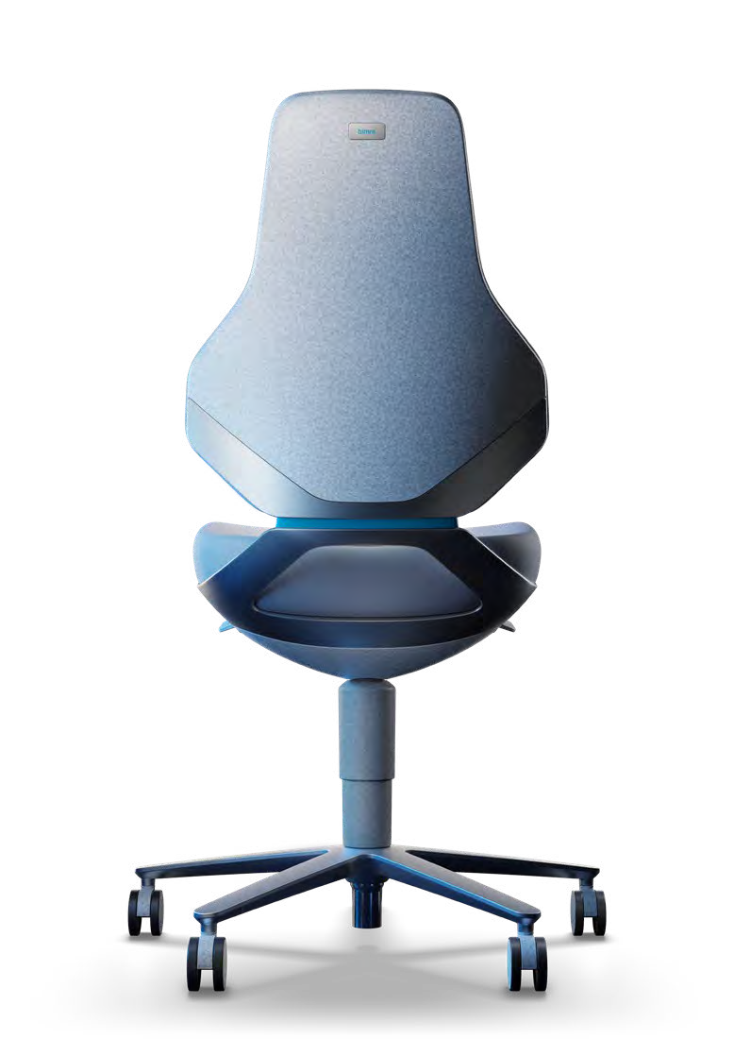
TEXON

Slide 2
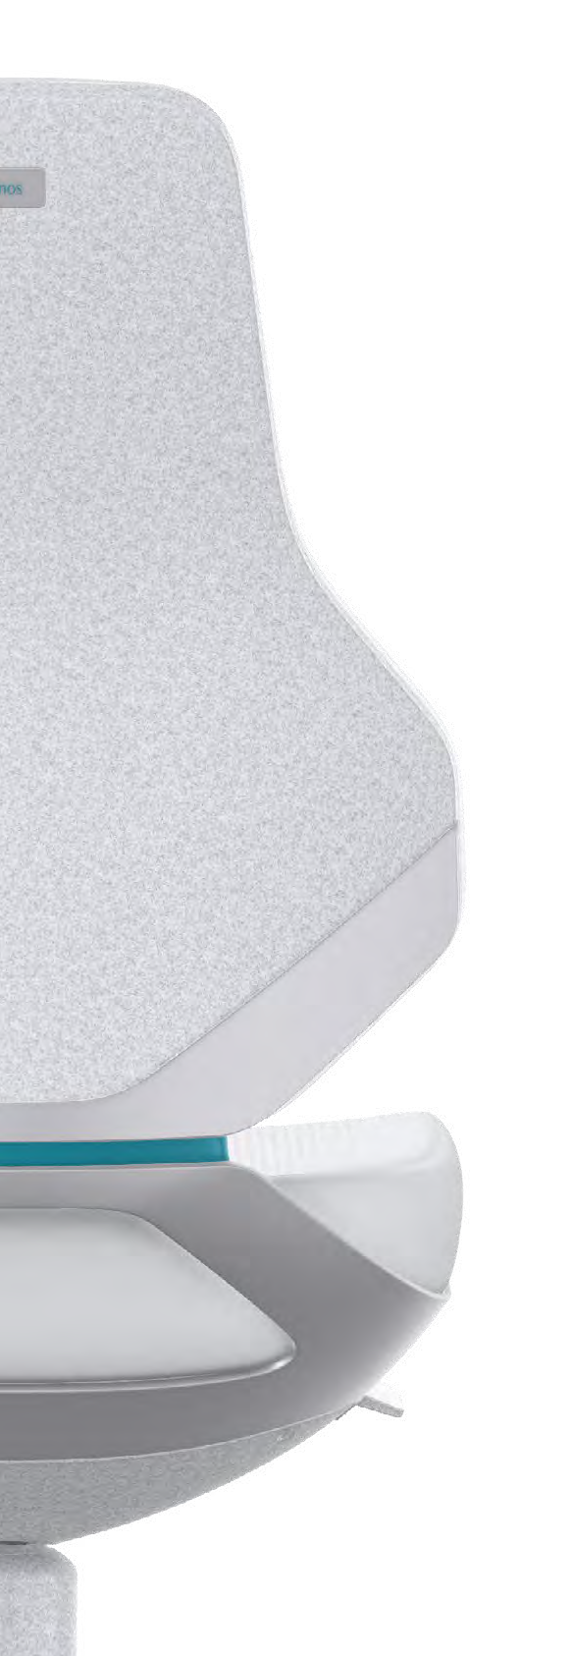
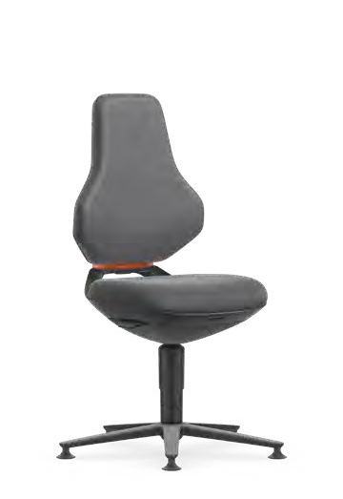
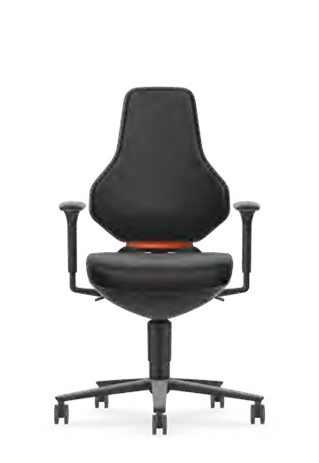
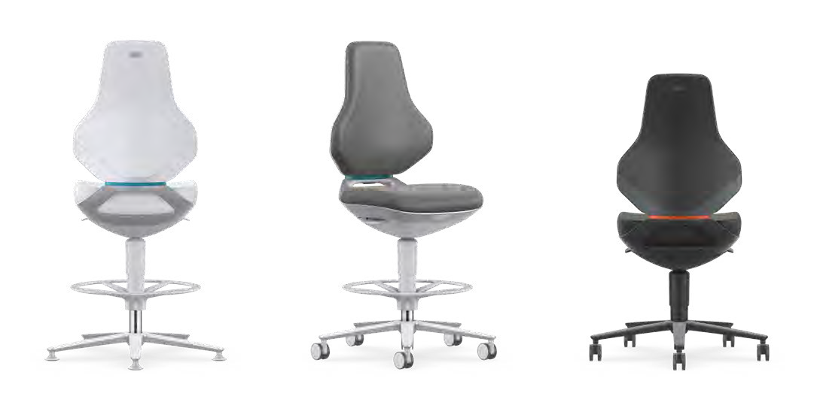
THE ONE
FOR HIGH-TECH INDUSTRIES
Unique and optimally equipped for any challenge: Bimos TEXON is the ideal chair for the demanding high-tech workplaces of the future. It combines innovative materials, hygienic design and maximum seating comfort. This means that it can cope with the challenges of an increasingly complex world of work. It sets new standards in cleanrooms and fulfils all requirements in ESD areas, laboratories and production environments.
Bimos is Europe’s leading manufacturer of the best industrial and laboratory chairs. For over 60 years, using our specialist knowledge, technical expertise and dedication, we have been ensuring that seating keeps people productive, healthy and happy at every workplace.

Slide 3
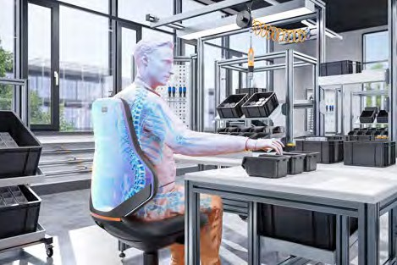
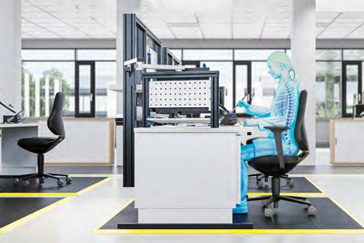
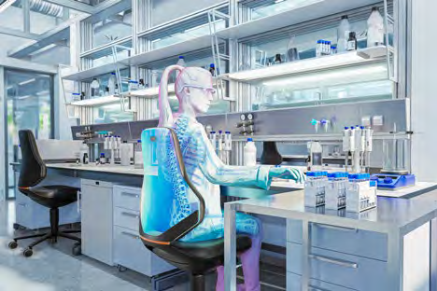
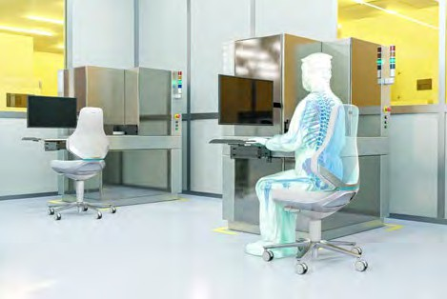
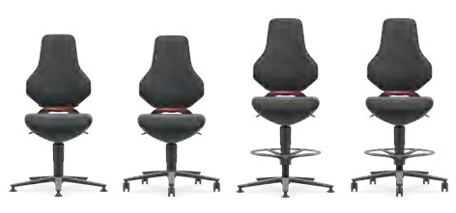
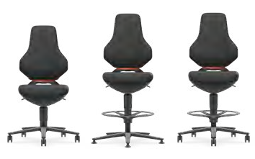
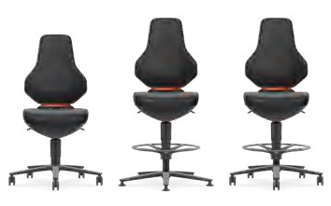
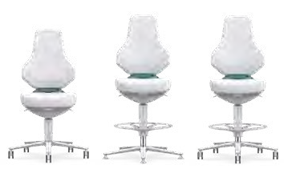
FOR WORK IN CHALLENGING
BIMOS TEXON
CONDITIONS – YOU NEED TEXON.
THE NUMBER ONE SOLUTION FOR HIGH-TECH WORKPLACES.
Production. Not only has the TEXON been designed for the everyday challenges of demanding production environments – it even guarantees comfortable seating in such cases, too. Thanks to its robust design and carefully selected durable materials, the chair can withstand even the most extreme loads. Impacts, aggressive oils, sharp-edged chips or flying sparks: All of these typical hazards in production environ- ments will do no harm to the TEXON.
ESD workstations. The ESD TEXON has been specially created to meet the high requirements for these sensitive workspaces. It protects against uncontrolled electrostatic discharges in high-tech manufacturing. Thanks to its standard-compliant materials and proven discharge capacity, it complies with the strict criteria of DIN EN 61340, ensuring that electronic components and sensitive devices are not endangered by static charge.
Laboratories. The LABORATORY TEXON has set the benchmark for laboratory chairs. Its consistent hygienic design ensures that the chair can be
thoroughly cleaned with great ease. All the materials used are resistant to commercially available disin- fectants. Moreover, the LABORATORY TEXON stands out on account of its striking design, which combines the best in function and aesthetics. Thanks to its robust design, the chair is perfectly able to withstand demanding laboratory conditions.
Cleanrooms and high-tech workstations. The CLEAN- ROOM TEXON is the ideal seating solution for the high-tech industry. It is certified for class 3 cleanrooms in accordance with DIN EN ISO 14644-1, and therefore satisfies the highest requirements. In addition, it guarantees reliable protection against electrostatic discharge in accordance with DIN EN 61340-5-1 – and therefore combines adherence to the highest stand- ards with effective protection for sensitive working environments.

Slide 4
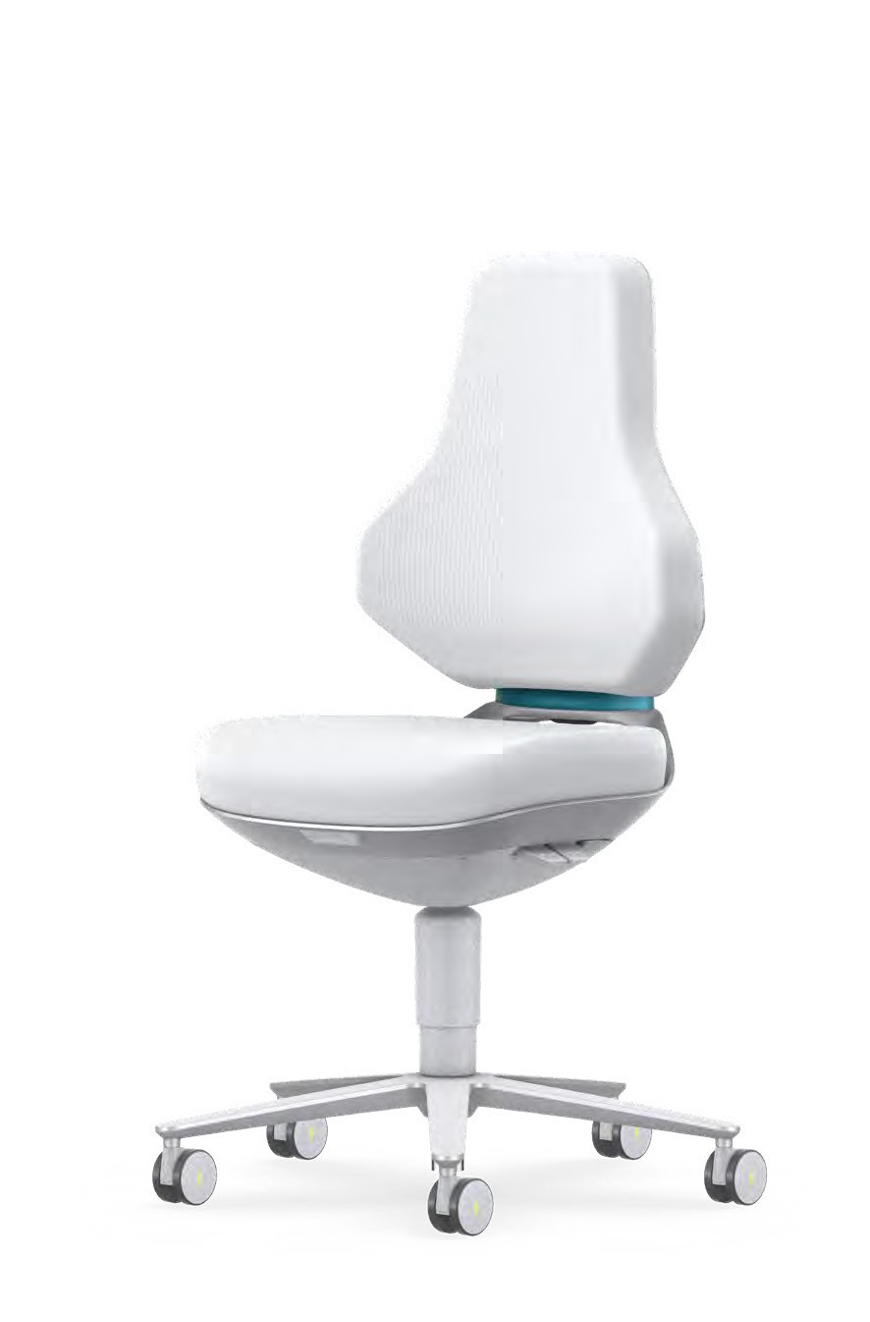
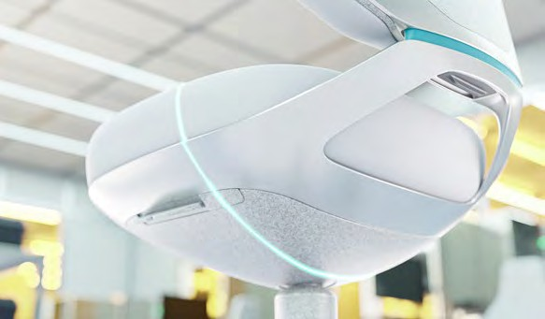
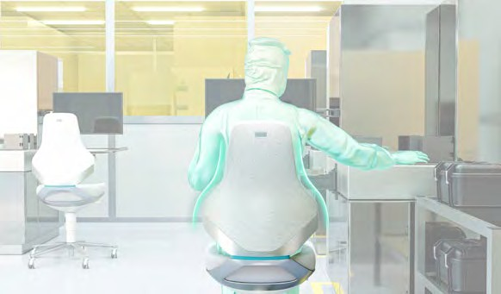
EXCELLENT FOR
FUNCTIONAL DESIGN
ALL STANDARDS.
The hygienic design of TEXON has been tested by Germany’s Fraunhofer Institute with regard to its functionality and areas of application. The assessment has verified that:
+ the chair can be completely cleaned by simply wiping it down
+ the modular design makes it possible to efficiently clean individual components
+ TEXON is optimally suited for production environments where cleanliness and hygiene are critical
+ TEXON adheres to the design recommendations of the European Hygienic Engineering and Design Group (EHEDG) and the standards ISO 14644-1, 14159 and 1672-2.
Hygienic design. The closed transition points and the smooth, seamless surfaces of the chair are specially designed to enable thorough and simple cleaning.
Moreover, the chair’s mechanism is protected by a washable clean cover, which makes cleaning even easier.
Tapered backrest. The design of the backrest provides more space for upper body movements (shoul- ders and back). The chair also gives the user more room to reach out to the side. This not only ensures additional comfort, but also great- er flexibility when working.

Slide 5
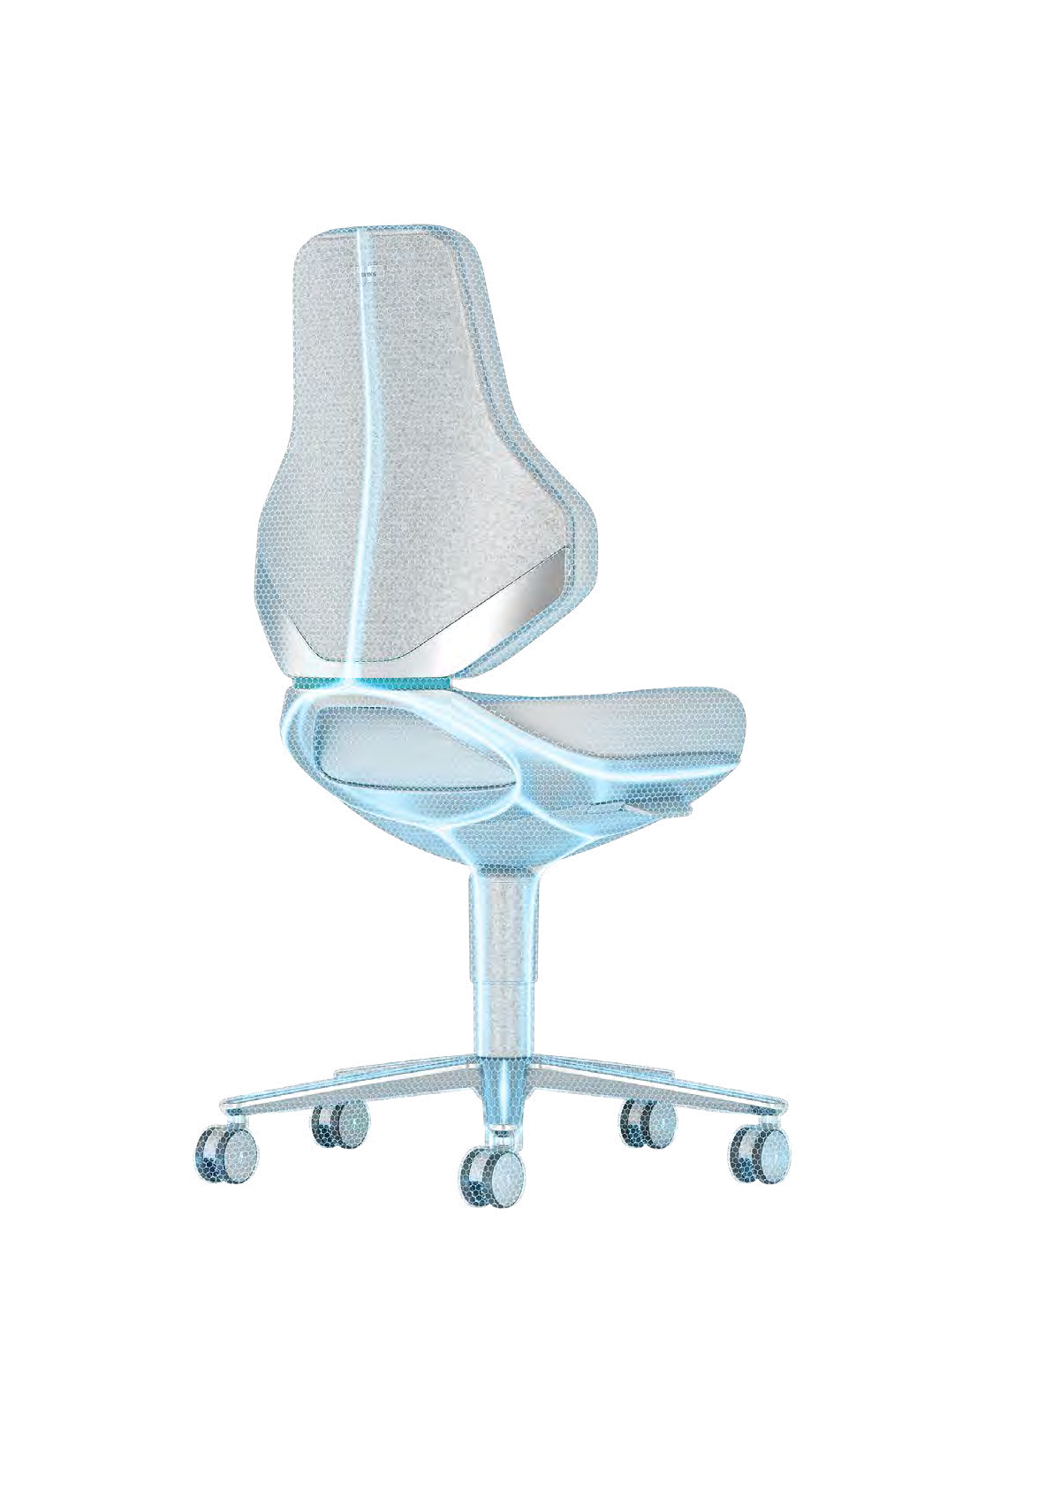
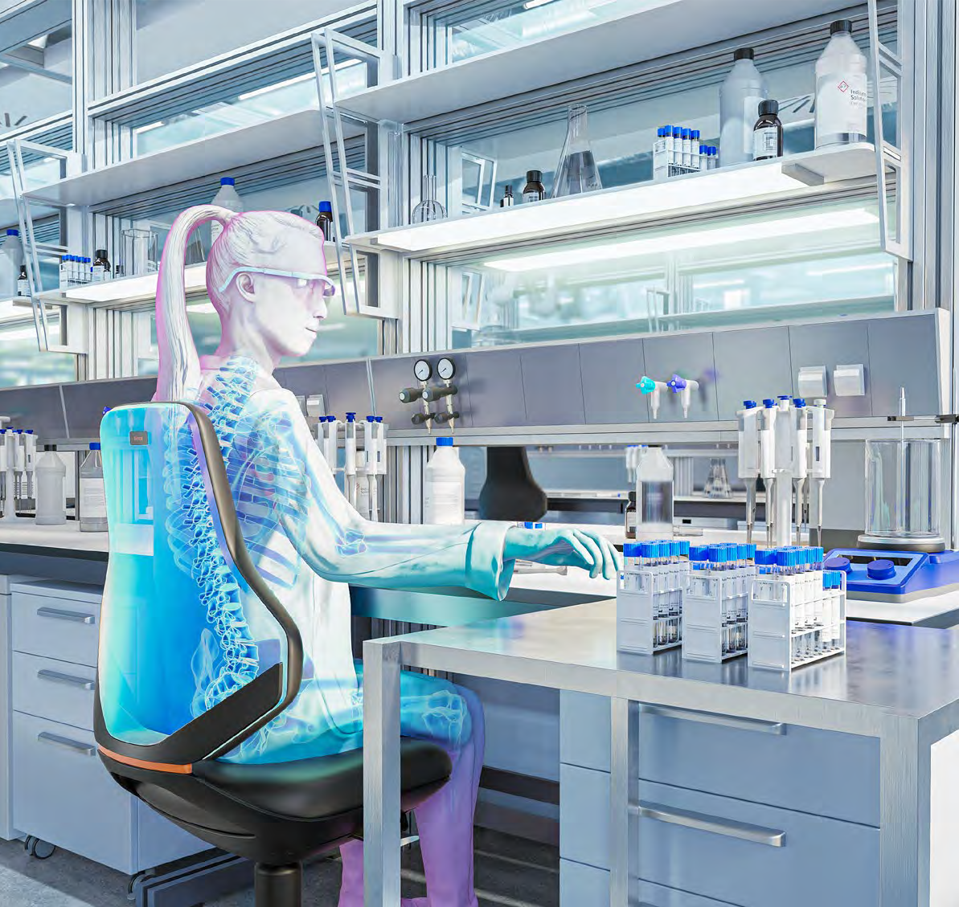
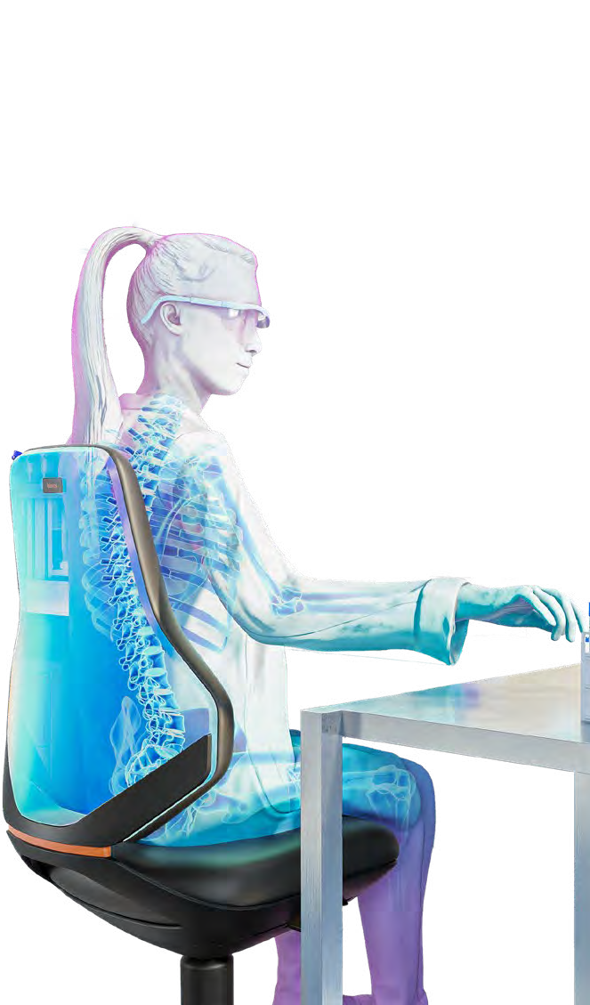
SUITABILITY FOR CRITICAL ENVIRONMENTS
No particle emissions. Smooth surfaces, seamless design and encapsulated mechanism.
UNCONSTRAINED WORKING
GMP-compliant. Fulfils the requirements of good manufacturing practice regulations
IN CRITICAL ENVIRONMENTS.
Hygienic design. For ease of cleaning and disinfection
Can be disinfected and is resistant to chemicals. Resistant to all common disinfectants and chemicals in accordance with ISO 2812 (Fraunhofer)
Can be used in biotechnology laboratories.
In line with safety classes S1, S2, S3 of the German Biological Agents Ordinance (BioStoffV)
GS-tested. For maximum safety (TÜV Rheinland)
Non-toxic. No toxins or emissions (TÜV Rheinland)
Suitable for cleanrooms.
For use in class 3 cleanrooms in accordance with ISO 14644-1 (Fraunhofer)
ESD-compliant. Overall ESD discharge across all components in accordance with DIN EN 61340-5-1. The typical discharge resistance is 106 Ω. All components and materials (e.g. upholstery, plastics, steel parts, castors) are volume-conductive and therefore guarantee the highest level of ESD safety. This includes the bright plastic parts, which are also volume-conductive – a particularly innovative and unique feature of this design.

Slide 6
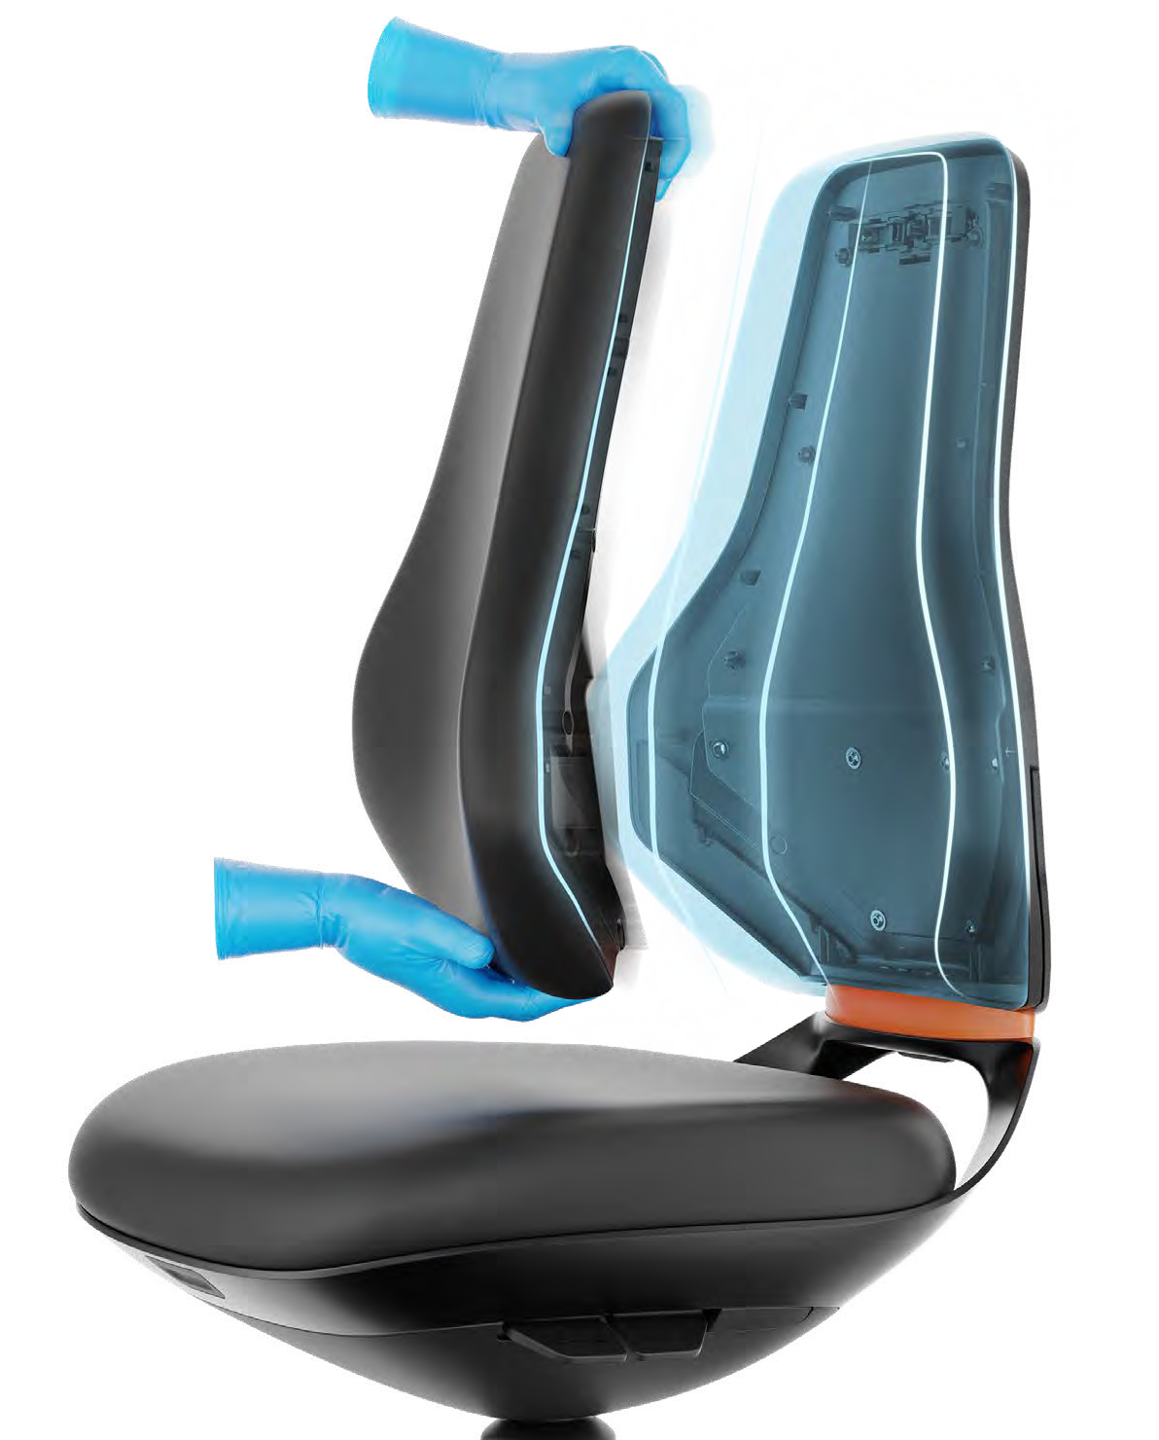
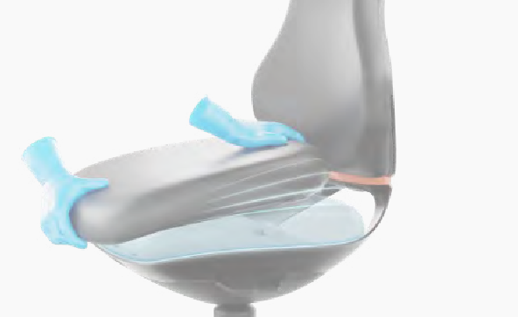
CHANGEABLE UPHOLSTERIES
THE UPHOLSTERY CAN BE CHANGED
IN SECONDS – MAKING IT PRACTICAL, SUSTAINABLE AND ECONOMICAL.
The back and seat upholstery of TEXON can be released with one simple click – and replaced just as easily. The significant ease of handling means that the process only takes a few seconds.
Sustainability. If new upholstery is required, the entire chair does not need to be replaced – the upholstery can be simply swapped out instead.
Economy. The chair represents a one-time investment, since its upholstery can be replaced as and when required. This makes TEXON an ideal product for the long term.
Easy to clean. By removing the upholstery, the surfaces and transition points underneath can also be cleaned without any issues.

Slide 7
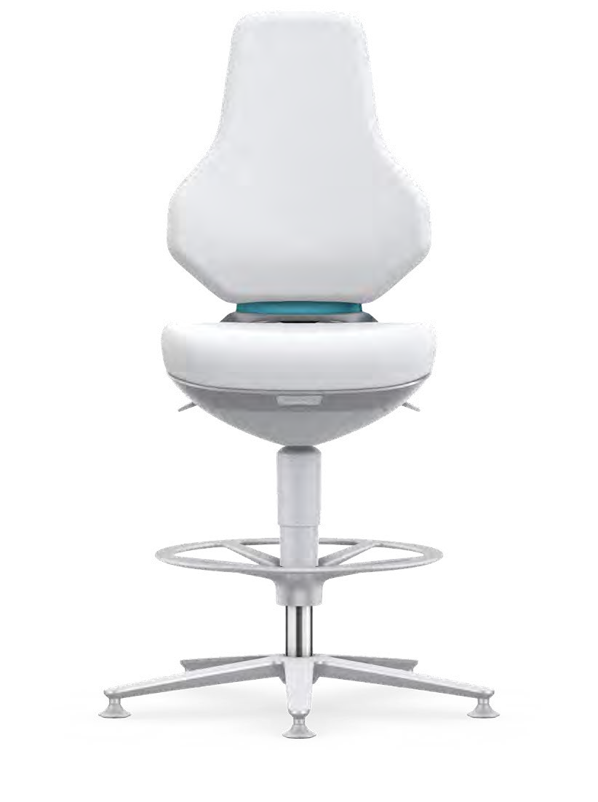
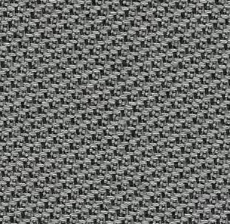
THE PERFECT UPHOLSTERY
COVER MATERIALS
SURFACE FOR ANY REQUIREMENT.
WORLD
DÉBUT
Duotec fabric. Particularly suitable for clean environments. The fabric covers are breathable and can also absorb and release moisture. The particularly soft surface ensures maximum comfort – even when sitting for long periods. Duotec fabric is hard-wearing and can be cleaned with standard upholstery cleaning agents.
Magic artificial leather. Durable, easy to clean and resistant to all commercially available disinfect- ants. It is free of PVC and plasti- cisers and remains supple for years. This reliably prevents cracks in the surface. Moreover, it is free of harmful phthalates and is neither detrimental to employees nor to the environment.
Supertec. A particularly innovative cover material. It is made from extremely hard-wearing, cut- resistant, non-slip micro-plating, as well as a soft backing material for optimal comfort. The breathable materials ensure a pleasant sitting experience even on hot days. Supertec is an easy-care material that is resistant to cleaning agents.
Skintec. This innovative uphol- stery surface has been specially developed for TEXON and stands out on account of its aesthetics.
The soft upholstery core guaran- tees exceptional seating comfort. Not only is this upholstery ex- tremely robust and hard-wearing – it’s also particularly easy to care for and is resistant to commer- cially available disinfectants.
+ Breathable
+ Comfortable
+ Hard-wearing
+ Fire safety tested in accordance with DIN EN 1021-1 and -2
+ Washable
+ Easy-care
+ Certified resistance to disinfectants
+ Soft and comfortable
+ Free of PVC and plasticisers
+ Fire safety tested in accordance with DIN EN 1021-1 and -2
+ Worldwide unique material
+ Robust and hard-wearing
+ Soft and comfortable
+ Easy-care and resistant to cleaning agents
+ Fire safety tested in accordance with DIN EN 1021-1 and -2
+ Non-slip
The innovative production process excludes any environmentally harmful substances. Altogether, this makes Skintec the perfect combination of sustainability, comfort, aesthetics, hygiene and durability.
+ Easy to clean, washable and resistant to disinfectants
+ Exceptional seating comfort
+ Shape-retaining
+ Resistant and hard-wearing
+ Conductive in all colours
+ Sustainable production process
+ Free of environmentally harmful substances (phthalate, PVC and softeners)
+ Fire safety tested in accordance with DIN EN 1021-1 and -2
+ Non-slip

Slide 8
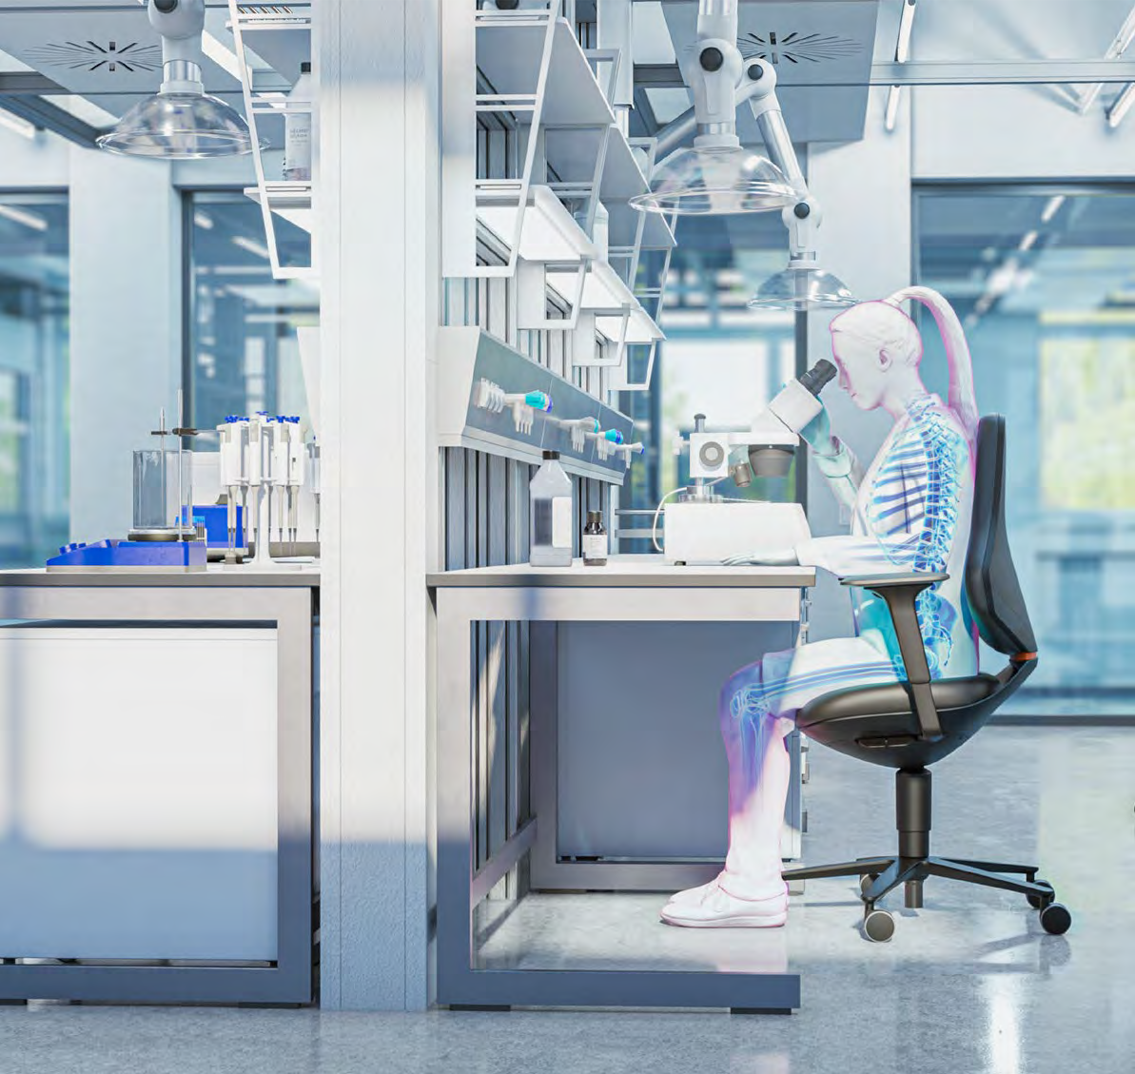
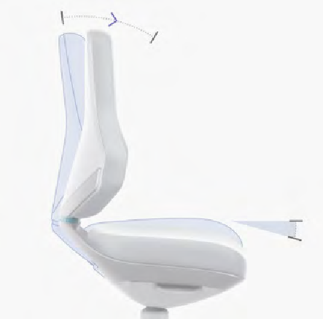
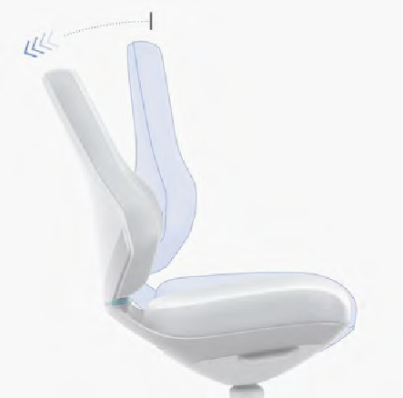
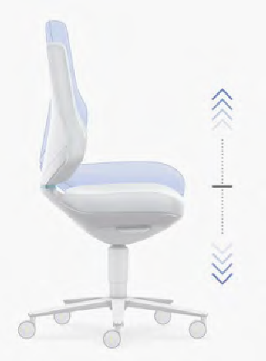
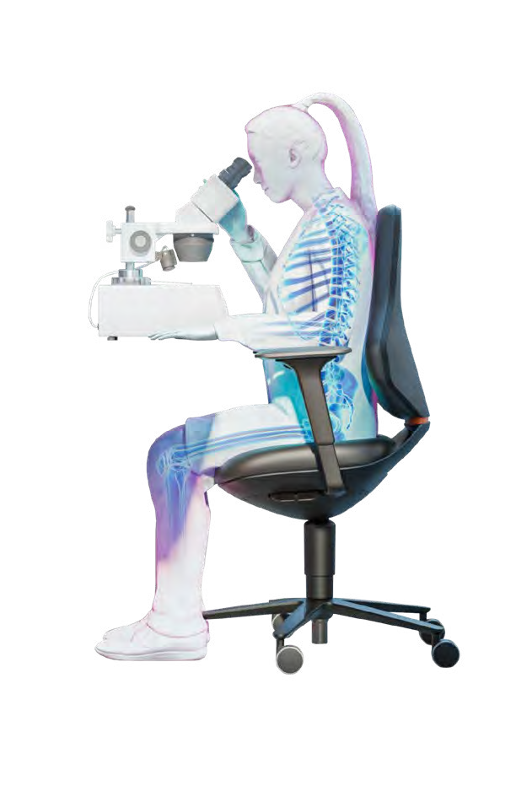
ERGONOMICS
INTUITIVE ERGONOMICS SHOULD
RESULT IN THE AUTOMATIC ADOPTION OF A GOOD SITTING POSITION.
Ergonomic workplace equipment is crucial for boosting the health, satisfaction and wellbeing of employees. High-quality workplace chairs play a key role in this: They encourage a healthy sitting posture, preventing back problems and physical strain. Investing in high-quality workplace chairs therefore represents an investment in your employees, and gives a clear sign that you appreciate them.
The TEXON sets new standards in ergonomics and actively contributes to employees’ wellbeing. As a result, the TEXON increases workplace satisfaction, making employees more inclined to stay with your company.
Automotion technology. Simultaneous forwards and backwards movement of the seat and backrest. The seat and backrest dynamically remain in contact with the body, creating a feeling of floating and gliding. The automatic weight regulation ensures that the backrests provide optimal resistance, supporting active-dynamic sitting. Each individual user is therefore supported intuitively, in a manner that suits their needs.
Flex Back. Increases the flexibility of the backrest and allows for slight, relieving movements in the back; can also be locked as necessary.
Seat height adjustment. The chair can be quickly and easily adapted to any body size and working height. This promotes an ergonomic sitting posture, improves blood circulation in the legs and prevents the build-up of tension.
Intuitively sit correctly: Take a seat and automatically adopt a good posture – without no need for any complex adjustments to the chair. This saves time for users, allowing them to concentrate fully on their work without worrying whether they’re sitting correctly. The chair’s design also promotes natural
movement and flexibility. This avoids any negative long-term impacts on health, and instead improves the general well-being and motivation of employees.

Slide 9
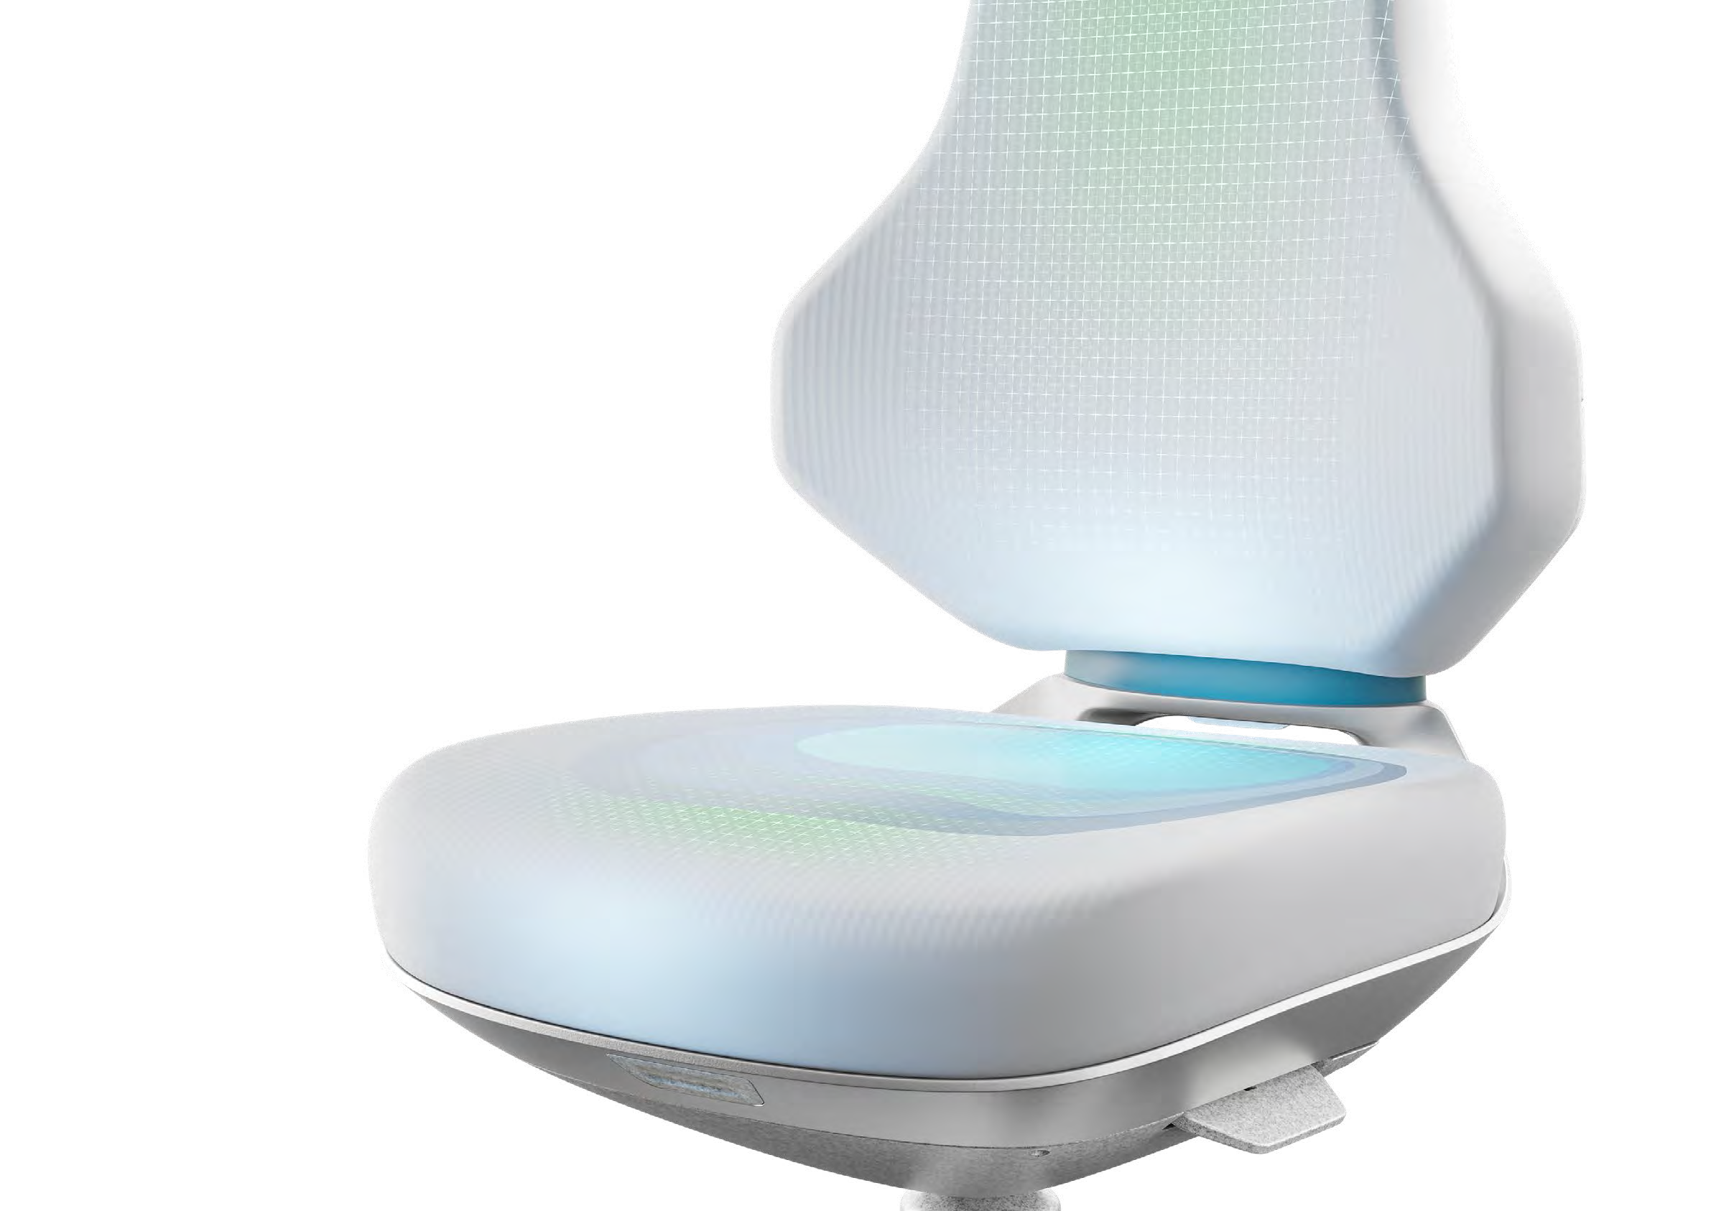
EXCEPTIONAL SEATING COMFORT
COMFORT UPHOLSTERY
FOR A FEEL-GOOD WORKPLACE.
The TEXON combines the highest technical and application-related standards with exceptional seating comfort. The extra-thick, extra-soft upholstery adapts optimally to the body’s contours and provides pleasant pressure relief. A wonderful feeling of comfort sets in as soon as you take a seat – a feeling that never gets old or goes away, even after repeated use.

Slide 10
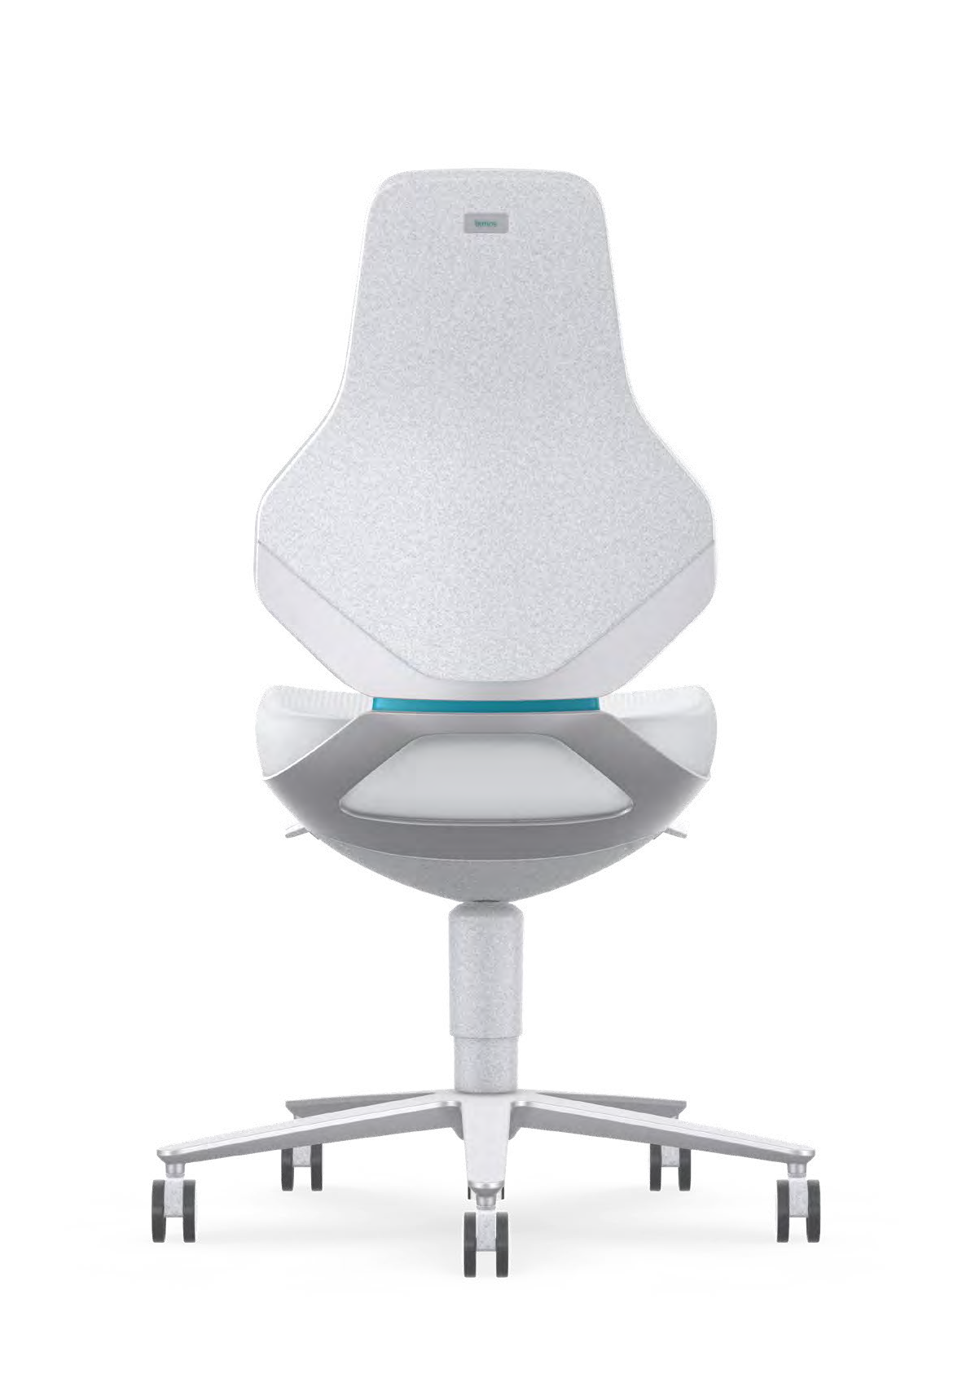
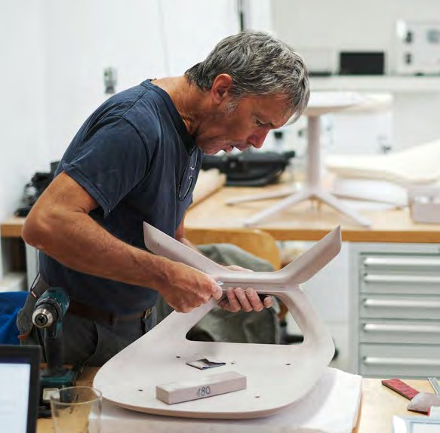
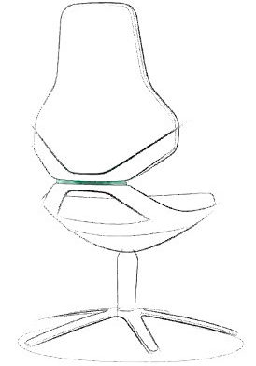
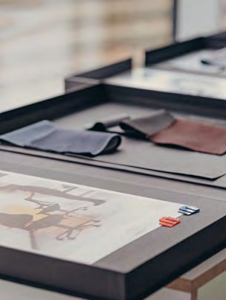
DESIGN
FUNCTION AT ITS BEST:
THE AWARD-WINNING DESIGN OF TEXON.
Appreciation. TEXON contributes to employees’ wellbeing on a number of levels. It enhances every workplace not only with its ergonomics, but also with its aesthetic and functional design.
Distinguished aesthetics. The design of TEXON comes from the renowned design studio PHOENIX. It stands out on account of its clear lines and closed silhouette. The iconic X-element serves as a central ergonomic and technological joint. TEXON com- bines the best in functionality and aesthetics. As testament to this, it’s been honoured with both the German Design Gold Award and the Red Dot Award.

Slide 11
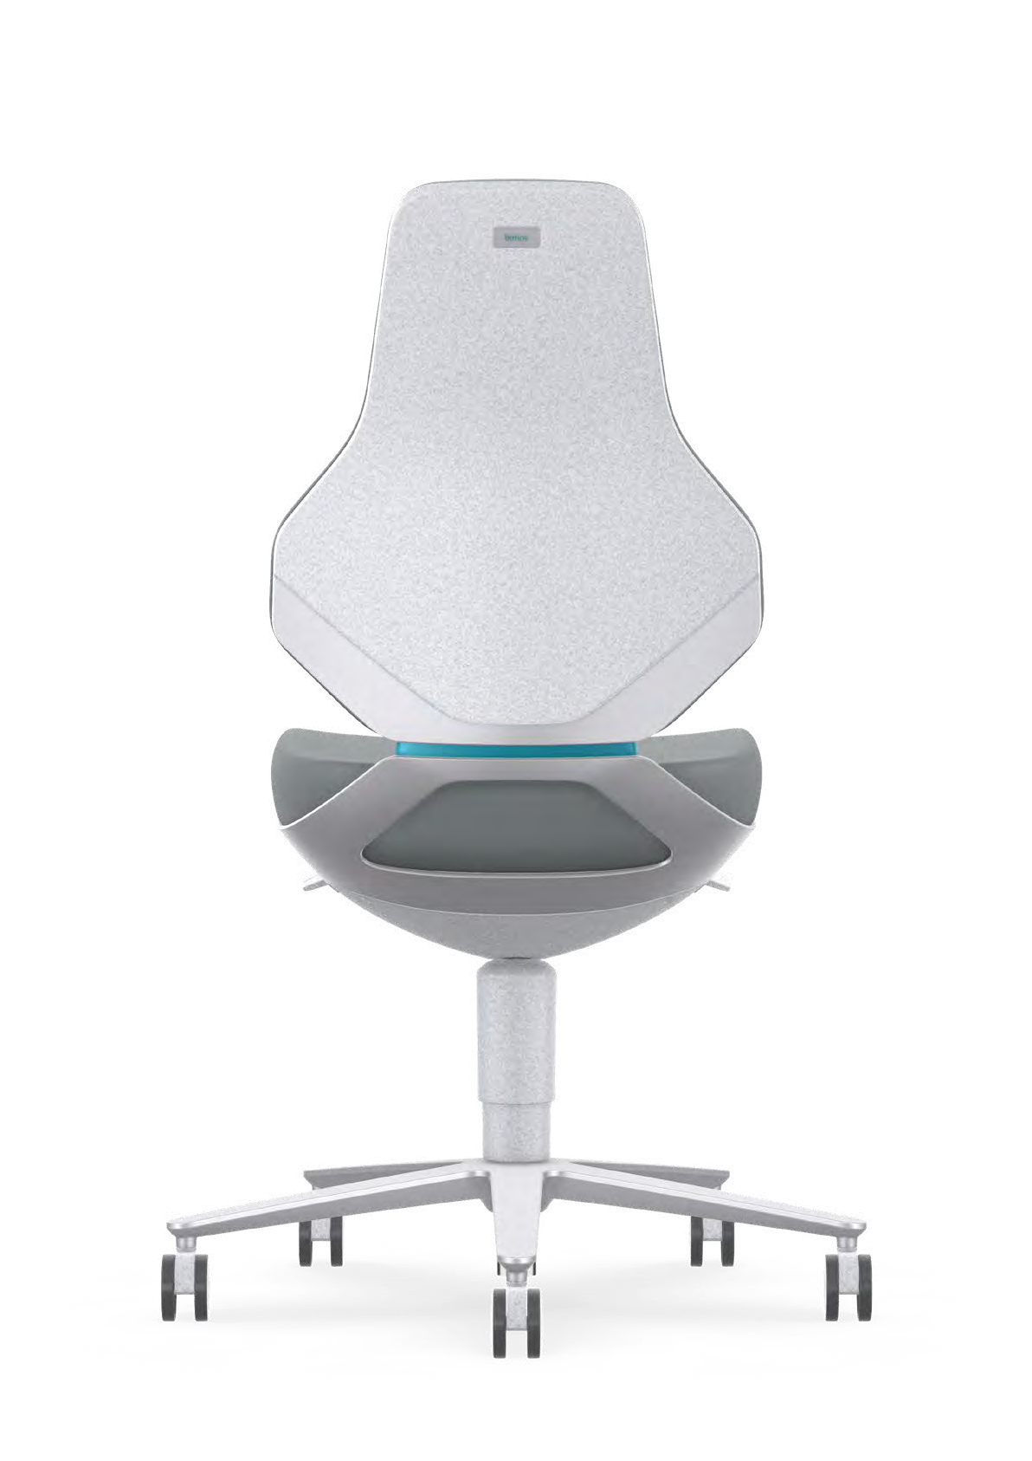
SUSTAINABILITY
ECOLOGICAL RESPONSIBILITY
AS A MATTER OF CONVICTION.
When it comes to sustainability, Bimos is setting the benchmark for the industry as a whole. From its production through to the very end of its usage life: The TEXON spares the environment and saves resources.
Durability. Bimos champions the use of high-quality materials and robust design to ensure a long service life. For this reason, it has
a 10-year warranty on all its products.
Modular design. Components such as upholstery, armrests and mechanisms can be easily replaced in the event of wear.
Recycling and circular economy. The TEXON is fully recyclable. All materi- als can be returned to the resource cycle at the end of their service life.
Sustainable production. For decades, Bimos has always placed great emphasis on sustainable production processes. This has been proven by certifications in accordance with ISO 14001 (environmental manage- ment), the EU Eco-Management and Audit Scheme (EMAS), and EcoVadis. The Interstuhl Group has received several awards for its low carbon footprint and its sustainable concepts.
Skintec. This innovative upholstery material is manufactured using
a resource-saving procedure and is particularly robust. This prevents material wastage – and guarantees a long service life.
Certificates and labels. The Bimos TEXON bears the “Blue Angel” German ecolabel – an environmental label that identifies low-emission and pollutant-free products. The chair fulfils the requirements of the FEMB level®, a European standard for sustainable furniture. The “Tested for harmful substances” approval seal verifies that the TEXON does not contain any substances that are hazardous to health.

Slide 12
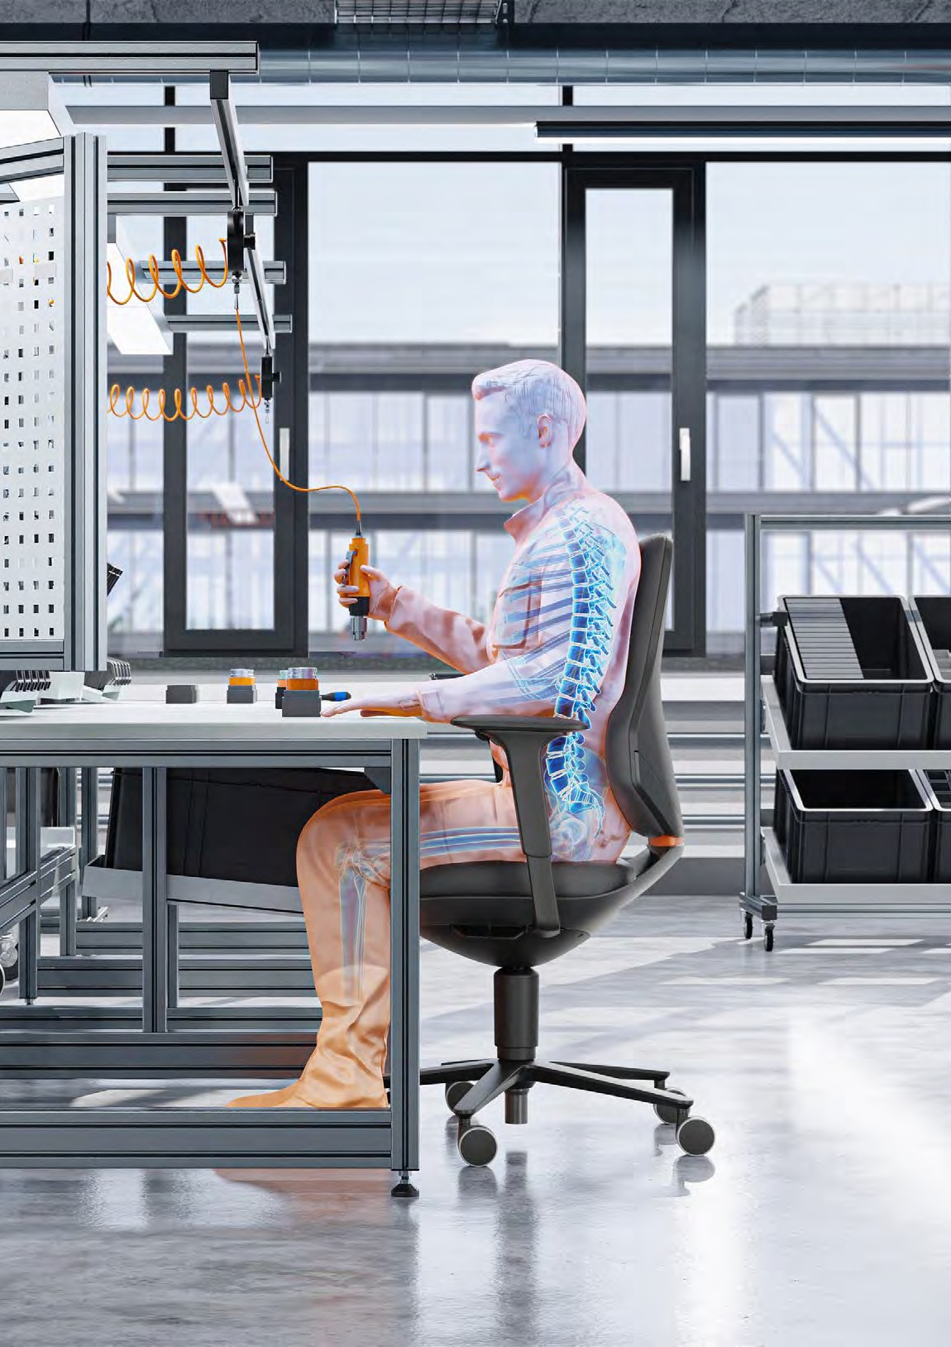
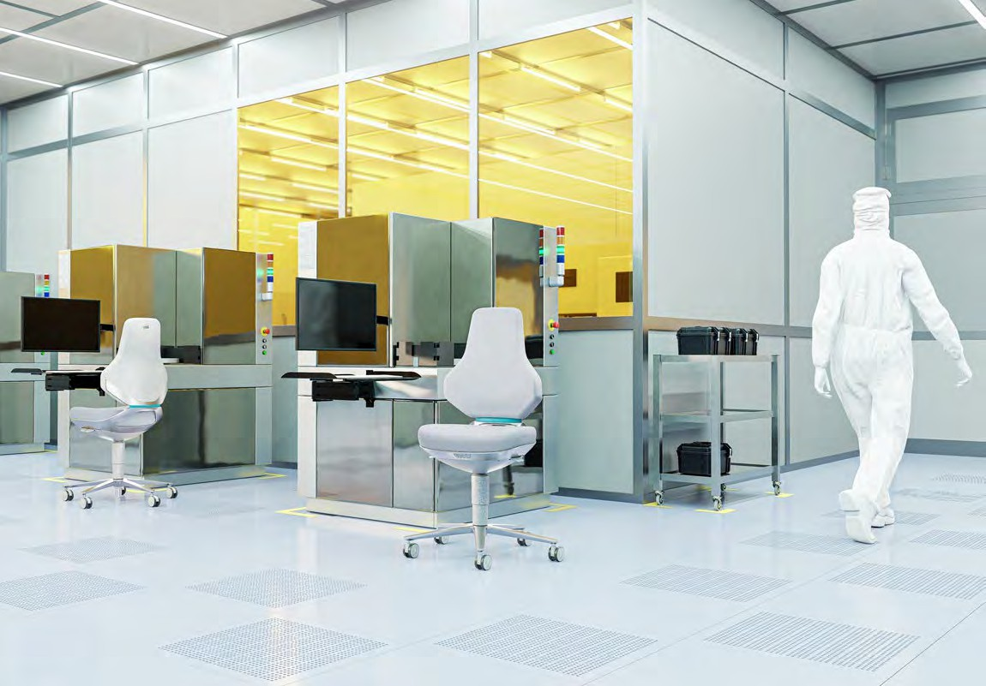
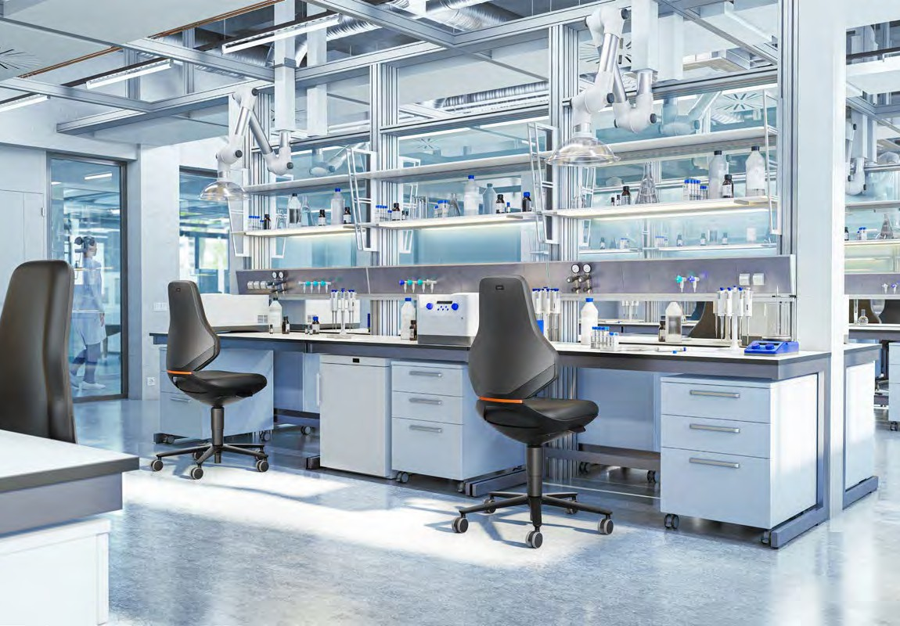

Slide 13
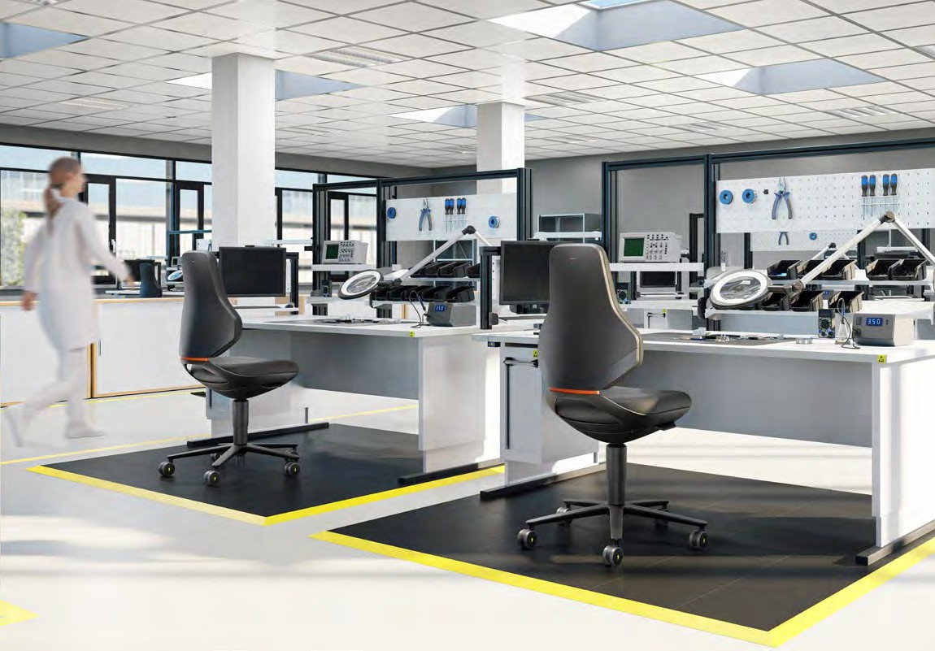
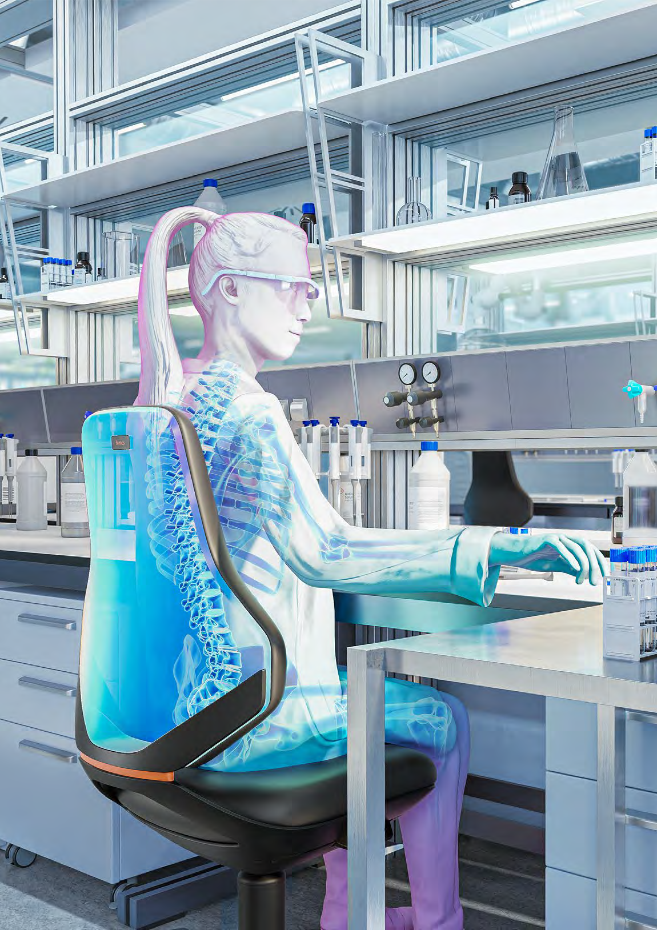
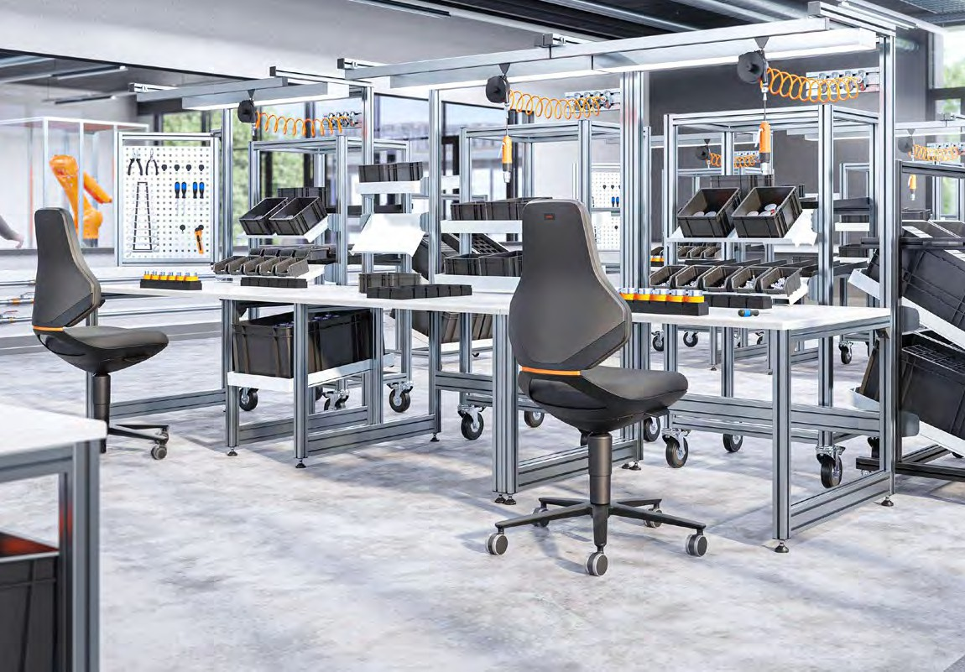

Slide 14
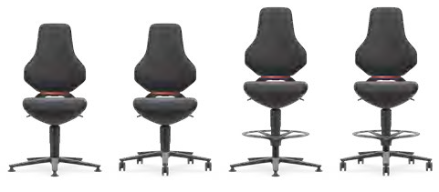
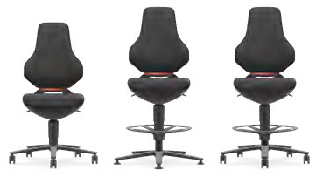
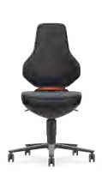
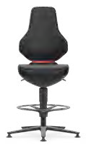
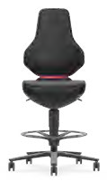
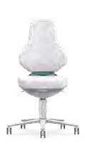
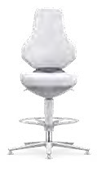
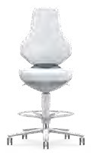
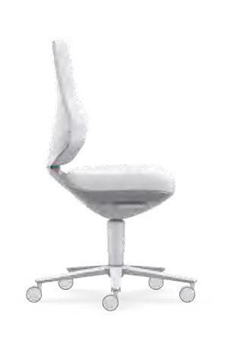
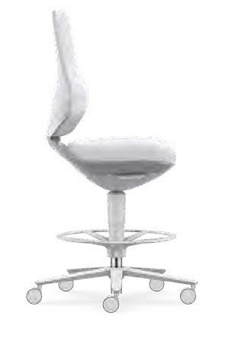
 |  |  | TEXON 1 | TEXON 2 | TEXON 3 | TEXON 4 |  | ESD TEXON 2 | ESD TEXON 3 | ESD TEXON 4 |  | LABORATORY TEXON 2 | LABORATORY TEXON 3 | LABORATORY TEXON 4 |  | CLEANROOM TEXON 2 | CLEANROOM TEXON 3 | CLEANROOM TEXON 4
 |  |  | Glides | Castors | Glides and foot ring | Stop & Go castors and foot ring |  | Castors | Glides and foot ring | Stop & Go castors and foot ring |  | Castors | Glides and foot ring | Stop & Go castors and foot ring |  | Castors | Glides and foot ring | Stop & Go castors and foot ring
Basic equip- ment/options | Colour |  | 9170 | 9173 | 9171 | 9175 |  | 9173E | 9171E | 9175E |  | 9173 | 9171 | 9175 |  | 9173R | 9171R | 9175R
Duotec fabric |  |  |  |  |  |  |  |  |  |  |  | – | – | – |  | – | – | –
Magic artifi- cial leather Skintec | For order number, see table with surfaces and colours
Supertec |  |  |  |  |  |  |  |  |  |  |  | – | – | – |  | – | – | –
Base, X swing arm, (foot ring)
Anthracite aluminium
–
–
–
Silver-grey aluminium
–
–
–
–
–
–
–
–
–
–
Plastic parts
Black
–
–
–
Mottled white
–
–
–
–
–
–
–
–
–
–
Automotion technology with Flex Back, automatic weight regulation and seat height adjustment
Accessories
4D armrests
9179
9179
9179
9179
9179E
9179E
9179E
9179
9179
9179
9179R
9179R
9179R
Foot ring
9178
9178
9178
9178
9178R
Standard
Option
Duotec fabric
Magic artificial leather
Skintec
Supertec
570 mm
1020–1190 mm
570 mm
Black
6801 / ESD 9801
Black
MG01 / ESD MG01
Black
4000 / ESD 4000
Black
SP01 / ESD CP01
1140–1380 mm
460 mm
460 mm
570–810 mm
Seat height
475 mm
Seat width
150 kg
Load capacity
19 kg
Weight
450–620 mm
Seat height
475 mm
Seat width
150 kg
Load capacity
16 kg
Weight
Grey
6811 / ESD 9811
Grey
MG11 / ESD MG11
Grey
4002 / ESD 4002
Grey
SP11
Ø 500 mm
Off-white
4007 / ESD 4007
Ø 700 mm
Ø 700 mm

Slide 15
Bimos – a brand of
Interstuhl Büromöbel GmbH & Co. KG
Brühlstraße 21
72469 Meßstetten-Tieringen
Tel. +49 7436 871-111
info@bimos.de bimos.com
COMPANY
PRODUCTS
We reserve the right to technical modifications. Content may contain typographical variations. This product is made from FSC®-certified and other controlled materials.
01/25: 2WTX_PRO01_IAEN
bimos.com/bimos-texon

